Slide 1
Final Project
- Tetris

Slide 2
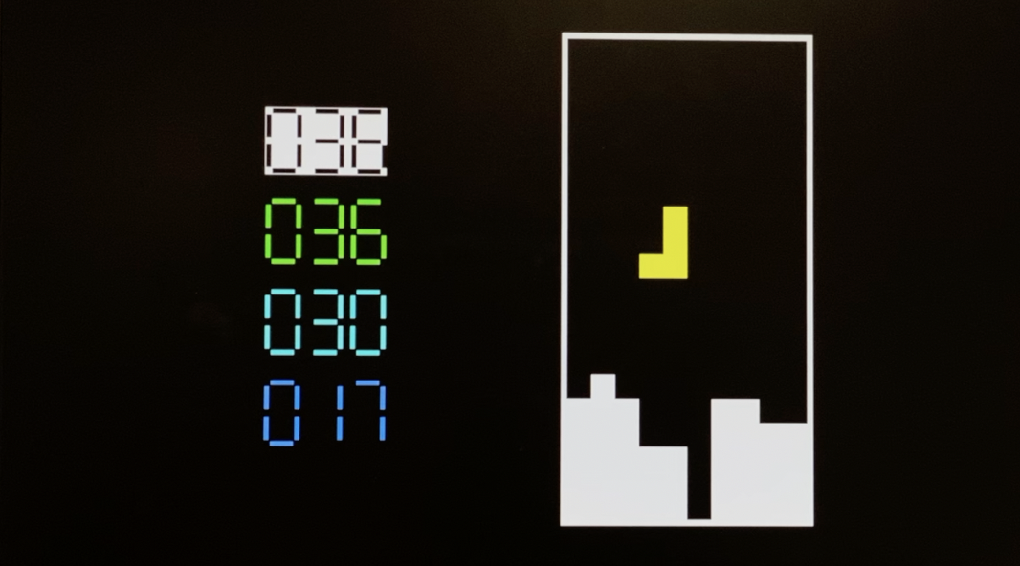
Overview
In this presentation, we will present
Accomplishments (short video)
Methodologies

Slide 3
Accomplishments

Slide 4
Accomplishments (Baseline)
1
I / O
2
Clear / Manage Lines
3
Rotation
4
Falling Pieces of Different Shapes
5
Scores

Slide 5
Accomplishments (Baseline)
1
I / O
Output: vga_screen
Input: PS/2 keyboard
Pause / Resume: P
Restart: R
Square movements: Up, Down, Left, Right

Slide 6
Accomplishments (Add-ons)
1
Interrupts
2
Speed Power-Up
3
Pseudo-Random Block Placement
4
Leaderboard

Slide 7
Accomplishments (Extra)
Use color to distinguish falling squares

Slide 8
Accomplishments (a Short Video)

Slide 9
Methodologies

Slide 10
Methodologies (Processor and MIPS)
1
Interrupts
5
Rotation
2
Speed Power-Up
6
Falling Pieces of Different Shapes
3
Pseudo-Random Block Placement
7
Scores
4
Clear / Manage Lines

Slide 11
Methodologies (VGA_Controllor)
1
Scores Display
2
Leaderboard

Slide 12
Thank you.

